Slide 1


Final Report
Trial Project
Aug 09, 2021
YOUR TRUSTED PARTNER
FOR SOFTWARE DEVELOPMENT
Author:
Phan Hải Long
Huỳnh Hữu Lộc
2021

Slide 2
Objectives
To learn how to work with real projects .
To experience a professional working environment.
Experience the work with time pressure and progress.
Manage and allocate time appropriately.
Learn how to prioritize each task for the assigned tasks.
Improve teamwork ability, how to coordinate with colleagues.
Know how to communicate between colleagues and superiors in a polite and respectful manner.

Slide 3
Application Introduction
Kanoo is a digital or mobile wallet that allows users to make secure payments and transfer money from their mobile devices. Users can connect to other users, manage their funds and take advantage of exclusive online discounts and promotions from merchants.

Slide 4



Technologies used

Slide 5
Library
com.squareup.picasso:picasso:2.71828
com.squareup.retrofit2:retrofit:2.7.1
com.squareup.retrofit2:converter-gson:2.1.0
com.squareup.okhttp3:logging-interceptor:4.9.1
androidx.recyclerview:recyclerview:1.2.1
androidx.lifecycle:lifecycle-viewmodel-ktx:2.4.0-alpha02
org.jetbrains.kotlinx:kotlinx-coroutines-core:1.5.0

Slide 6

Splash Screen

Slide 7
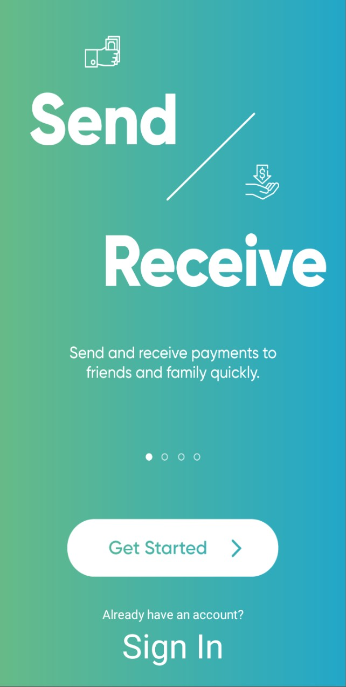
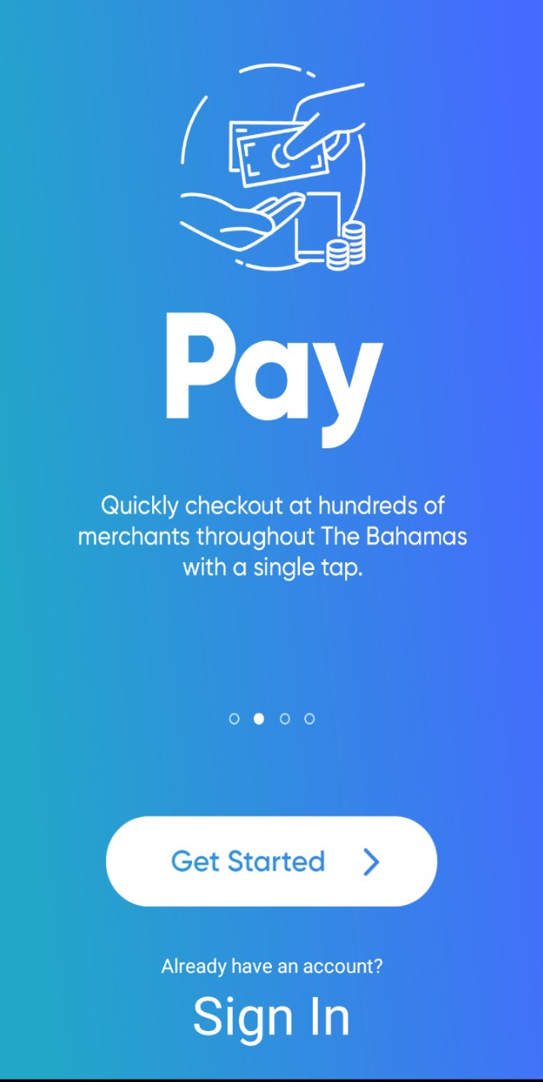
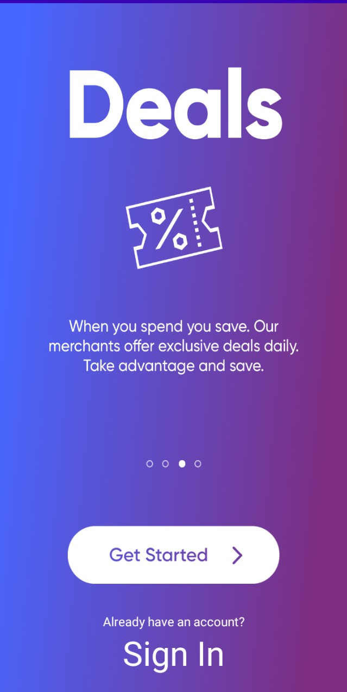
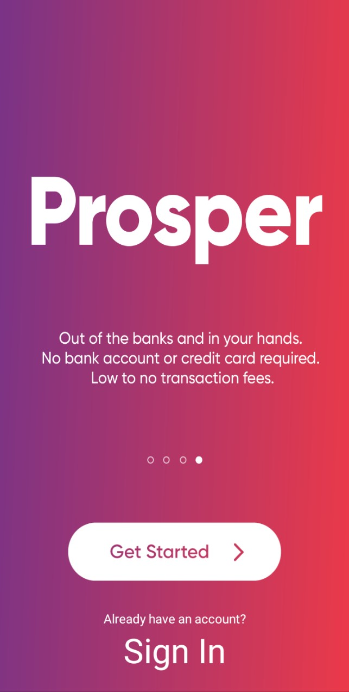
Walk-through Screen

Slide 8
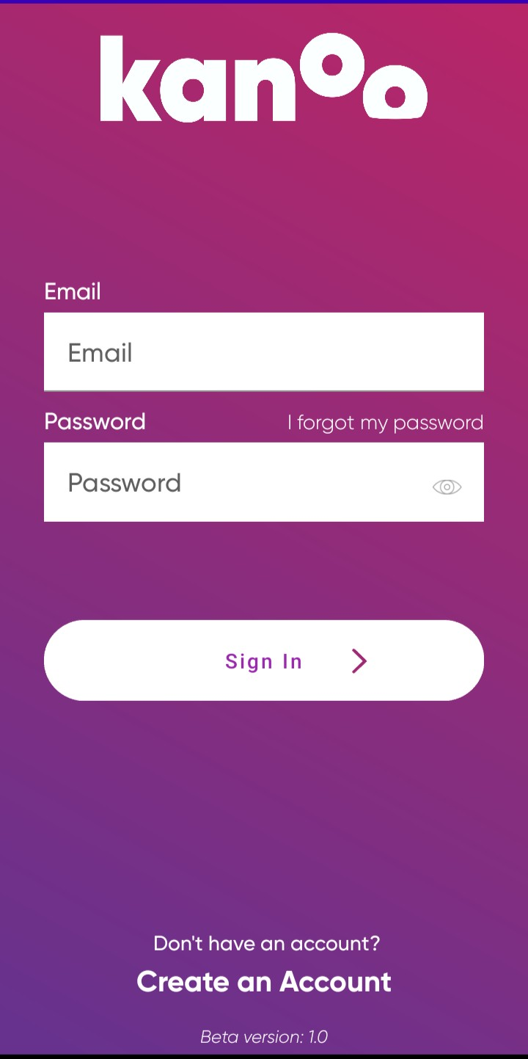
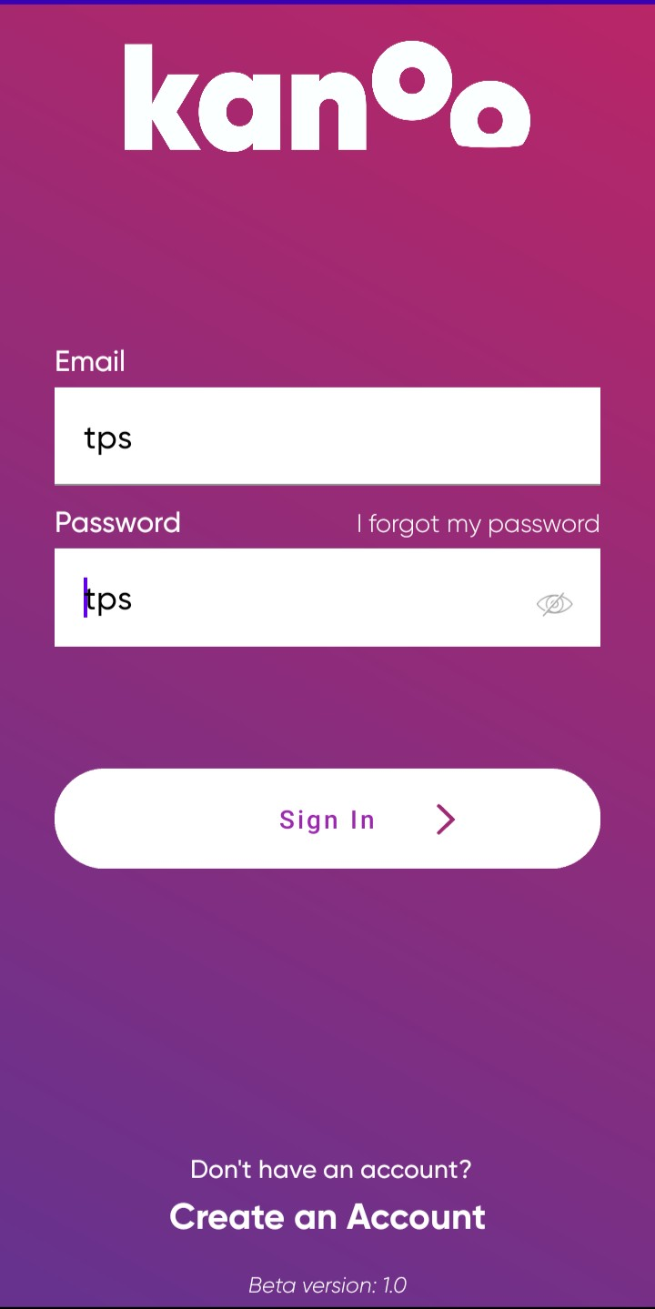
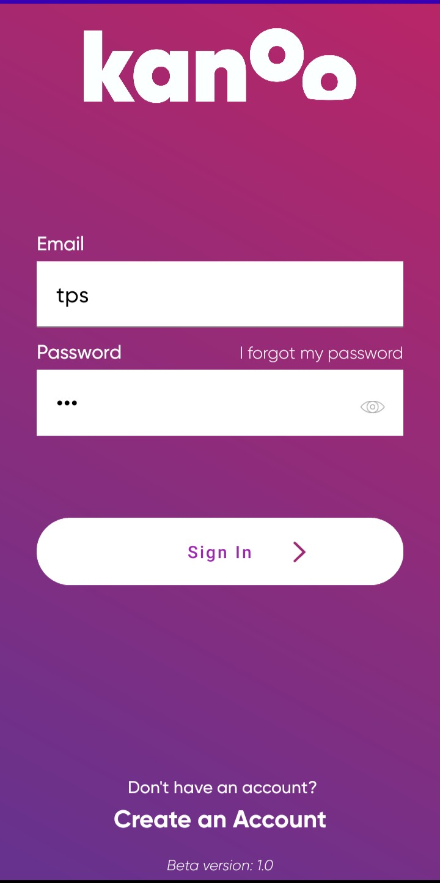
Sign In

Slide 9
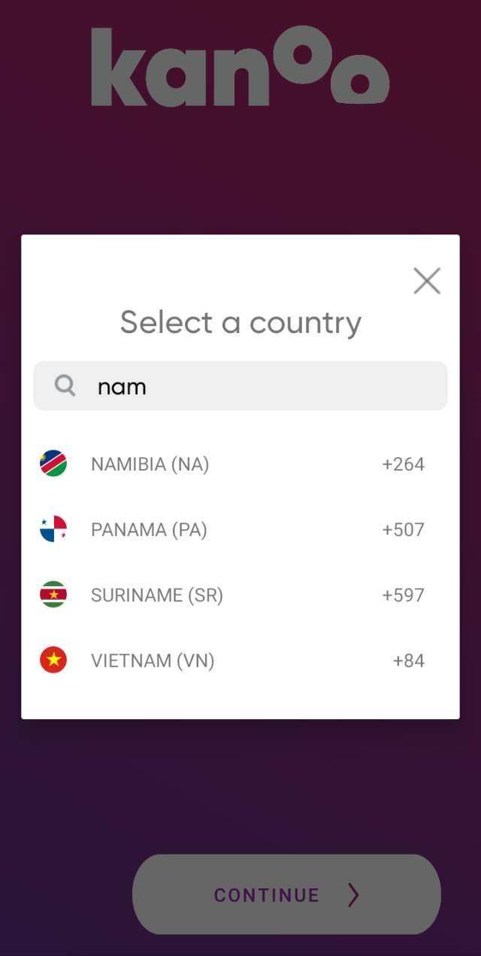
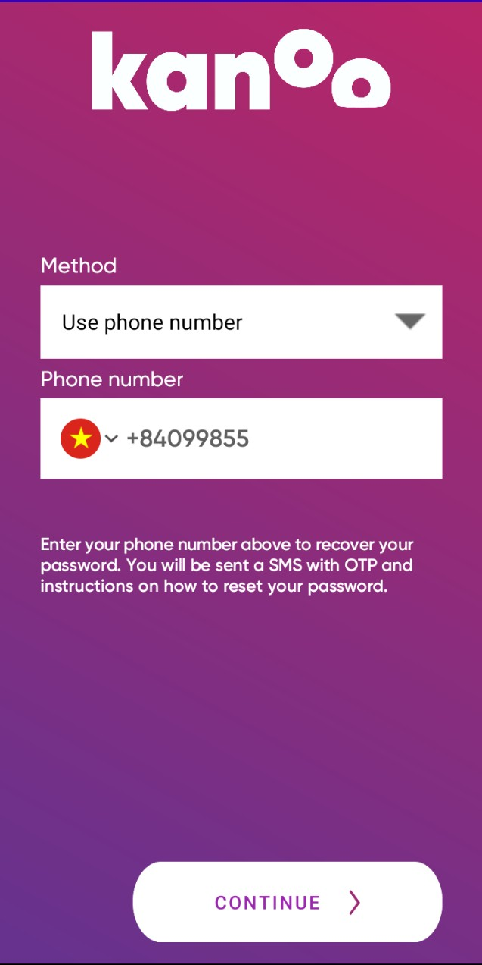
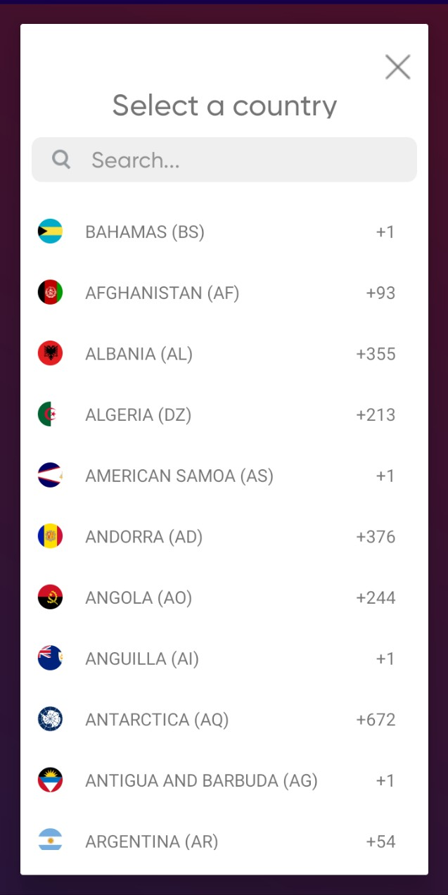
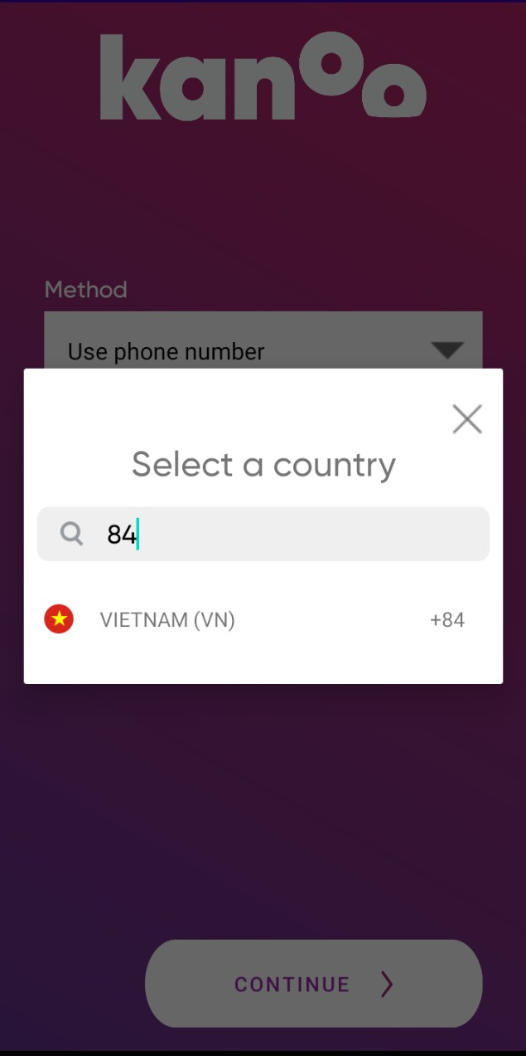
Forgot Password

Slide 10

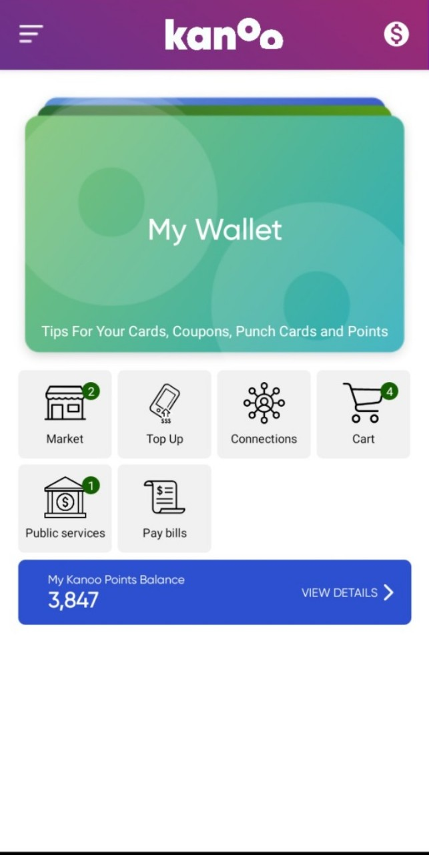
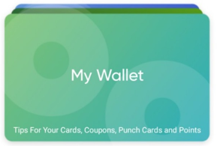
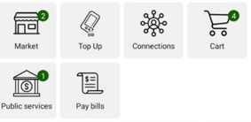

Main Screen

Slide 11
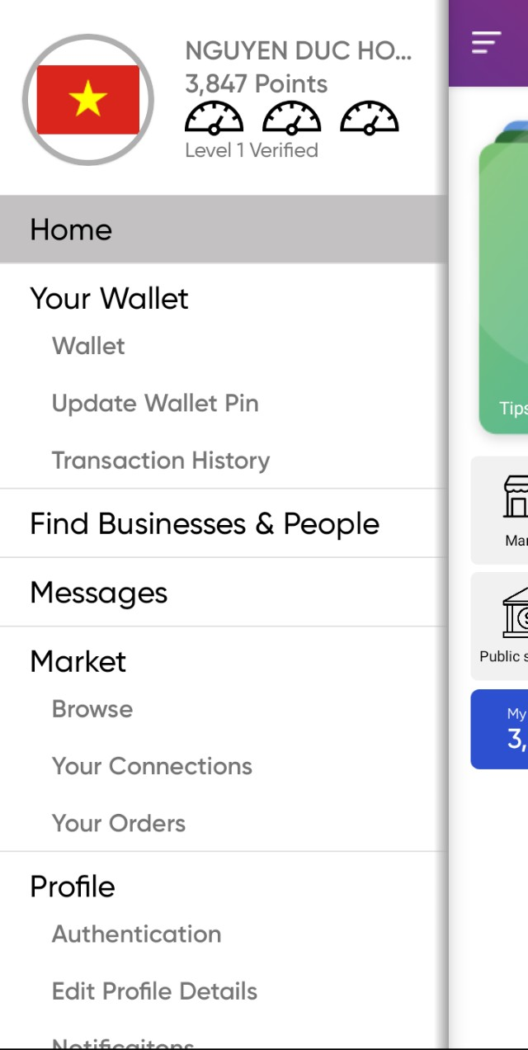
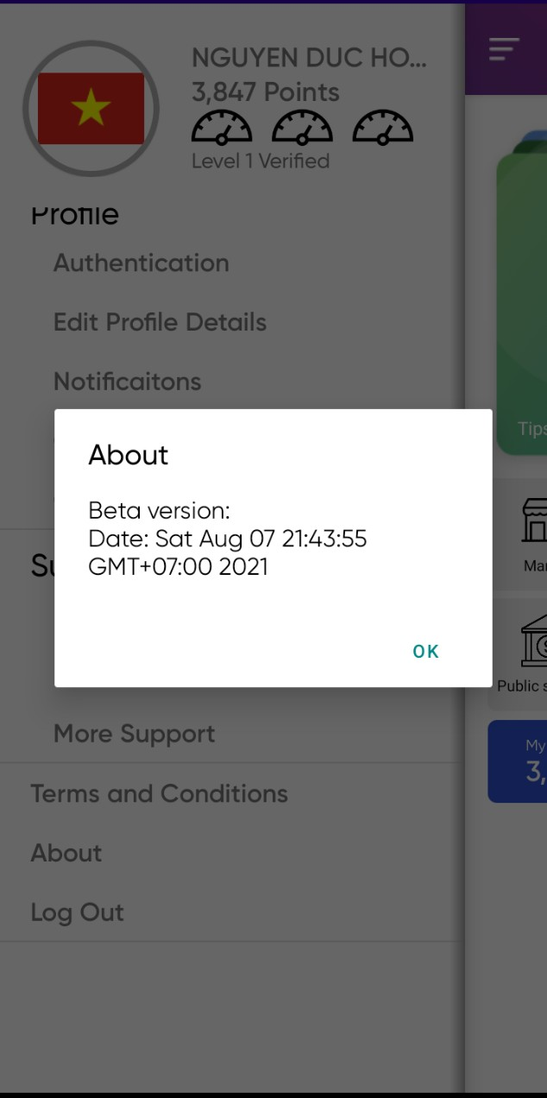
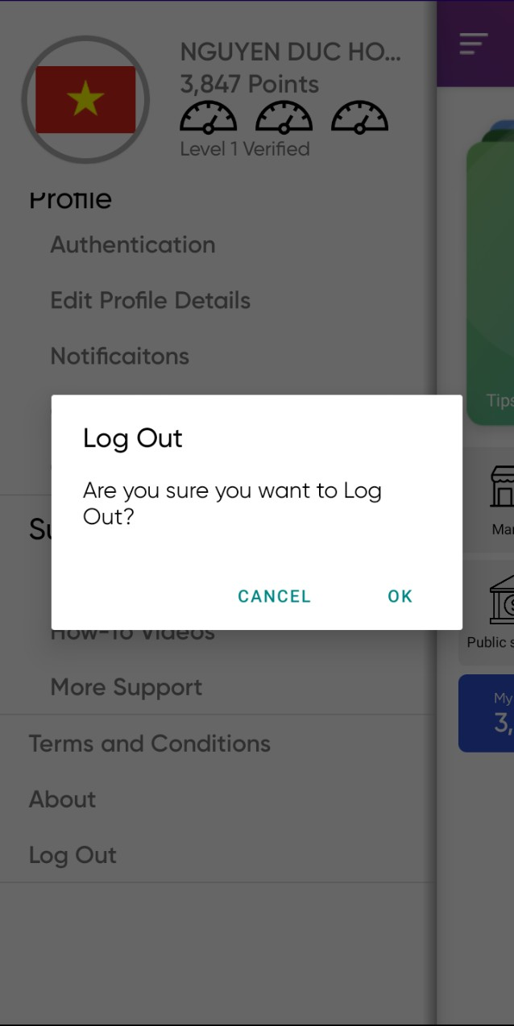
Left Menu

Slide 12
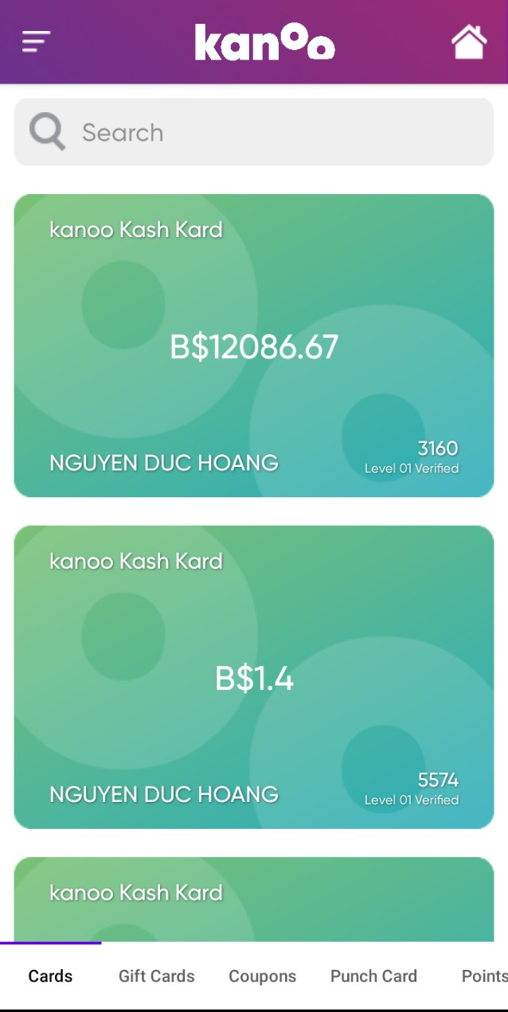
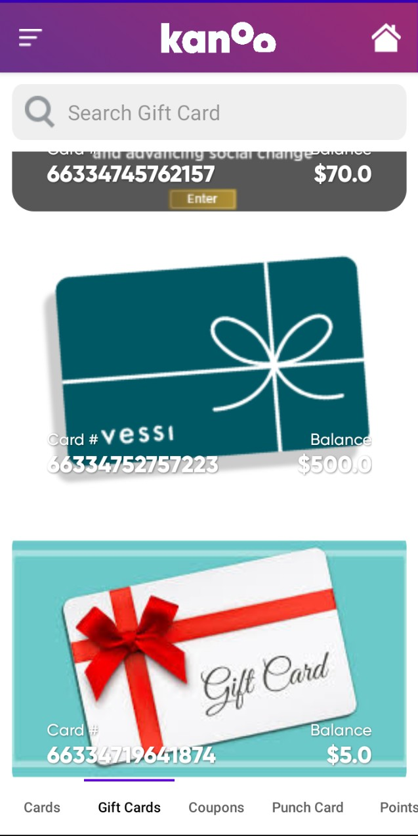
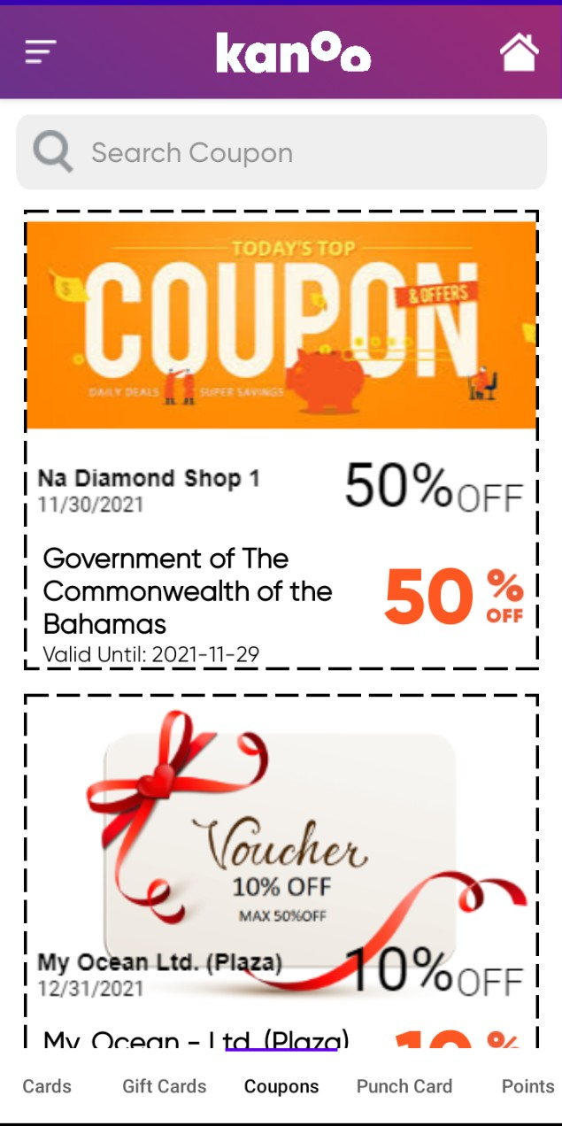
Cards Screen

Slide 13
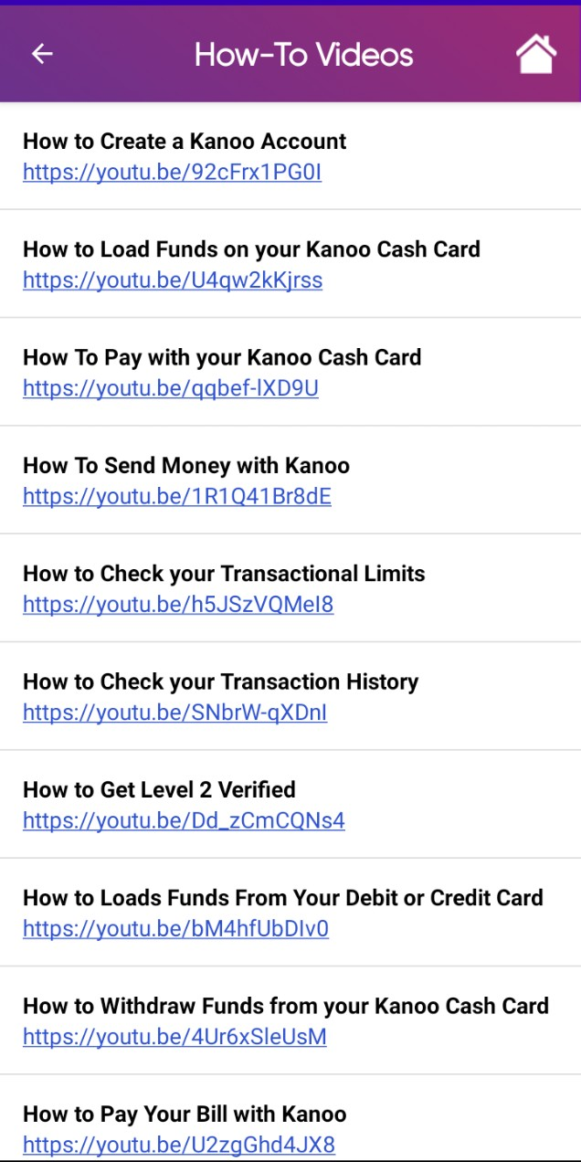
How to videos

Slide 14
THANKS FOR LISTENING

